Slide 1

Task Presentation Data Collection and Preprocessing
Development of AI base Road Inspection System
Presentation by: Tariq Jamil (Task-Lead)
https://www.linkedin.com/in/tj-yazman/

Slide 2
Introduction
The Project:
Development of ML Model to analyse and classify the road defects into pre-determined classes, by using relevant image datasets.
The Task:
Collection of the images concerning ‘Crack’, ‘Grooves, ‘Rut’ & ‘Subsidence’
Preprocssing the images as per modeling criteria

Slide 3
Collection of Images
Resoruces:
The entire project team was motivated to collect the images for all the 4 classes as per project requirements.
The Approach:
‘The more, the better’ approach was adopted for this phase, as it was expected that a substantial numbers could suffer from duplicates, irrelevant or insufficient sizes.
Progressive Reviews: Regular meetings and Task progress reviews were carried out for record and reference
https://drive.google.com/drive/folders/1NKV6KPVj4lIwuSlqRoTJ-_exK8kMpayi?usp=share_link

Slide 4
Collection of Images
The Process:
Images were collected using various methods, e.g.;
web downloads
web scraping
self captured images; etc.
Time Saver Images Collecting Manner (TSICM) (shared and elaborated by M. Solomon)
Collection:
A total of 33871 raw images were collected with following distribution.
Crack | Grooves | Rut | Subsidence | TOTAL
22318 | 3794 | 601 | 369 | 33871

Slide 5
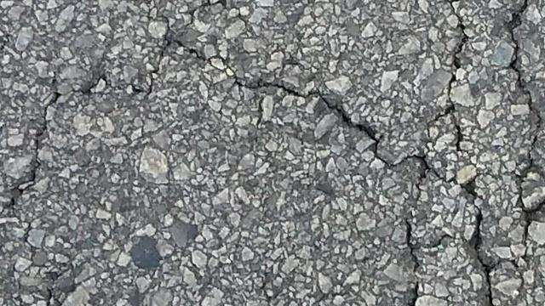
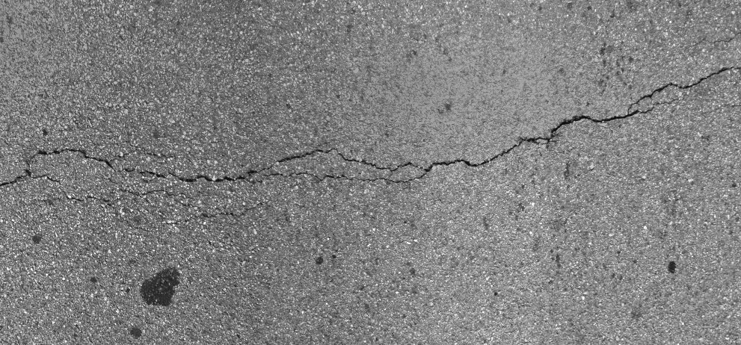
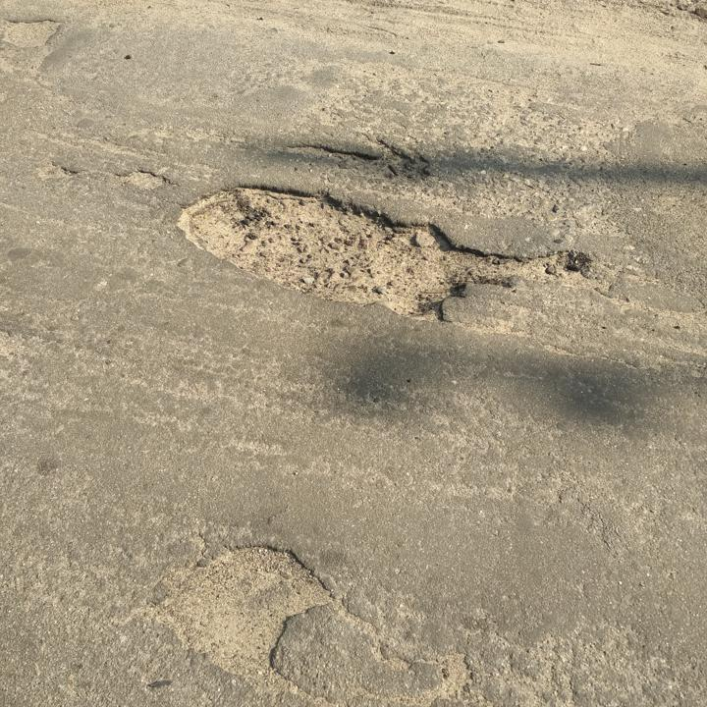
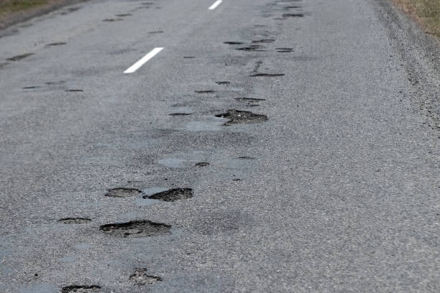
Class Samples
Crack
Groove
(pot-holes)

Slide 6
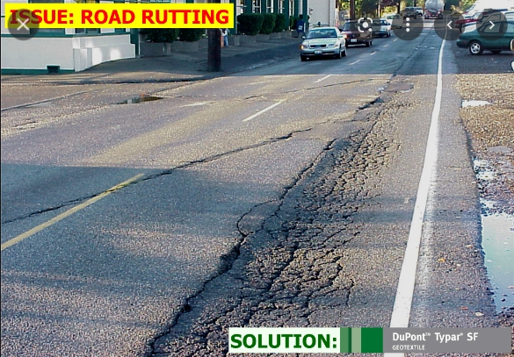
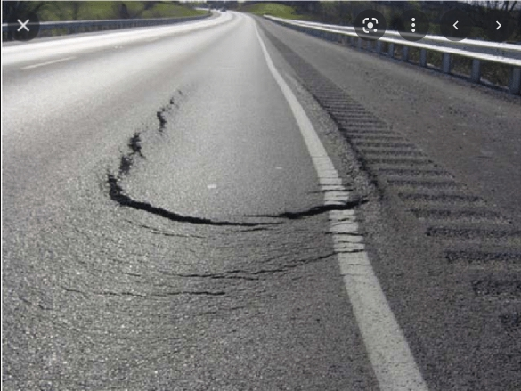
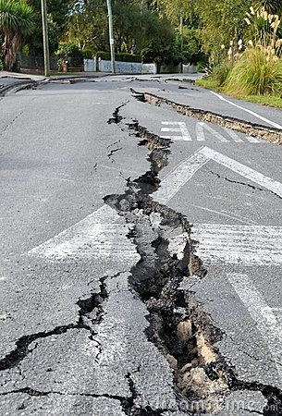
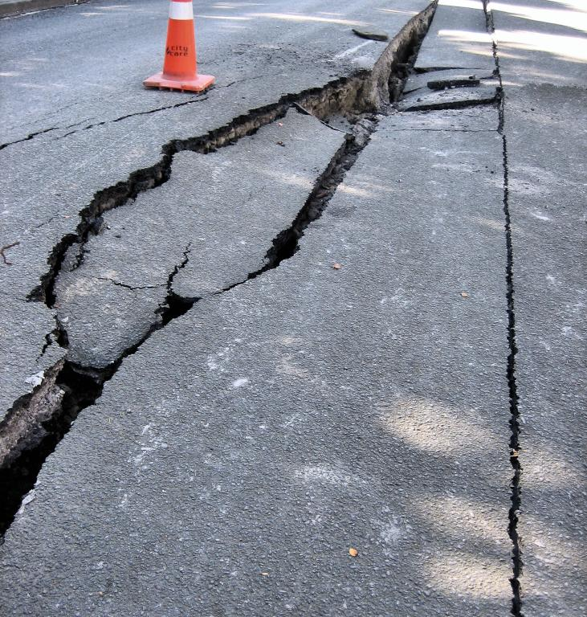
Class Samples
Rut
Subsidence

Slide 7
Image Samples Contributors
# | member | Images added | # | member | Images added
1 | Aditya Arya | 533 | 11 | Mohamed Soliman | 173
2 | Alaa Sedeeq | 1073 | 12 | Mohammad Usman Sheikh | 575
3 | Ataliba Miguel | 4 | 13 | Muddassir Mujawar | 20
4 | Chithra Janardhana* | 1757 | 14 | Muhammad Shahroz | 201
5 | Christo Mathew | 399 | 15 | Nimmi Joseph | 134
6 | Doktur Ugur | 6800 | 16 | Omitoogun Baseet | 24
7 | Efrem Assefa | 1262 | 17 | Raghvueer rajput | 18
8 | El Hassan Outlaouait | 188 | 18 | Riyad worku | 13
9 | Jamaludeen Madaki | 19 | 19 | Satvik Tejas | 363
10 | Karthik V G | 315 | 20 | Shubham Makwana | 20000
* Chitra added an additional 2000+ images for Crack+Groove classes before modelling

Slide 8
Preprocesssing
Resoruces:
Around 10 members participated in various phases of data / images preprocessing.
Data Requirements
Images size min 300x300 pixels
.Jpeg format
Color = RGB
Dominant features should be representative of the class concerned
free from objects/features which may potentially confuse the model in wrong direction

Slide 9
Preprocesssing
Phases / Steps:
Images were verified for correctness of class, and measures applied as required in regards to image labeling/classification-correction
Removal of duplicates by using various techniques
Cropping of extra images for undesired objects (e.g. vehicles, humans, trees etc.)

Slide 10
Preprocesssing
Class Annotation:
The preprocessed images were placed in class-named folders in line with tensorflow data pipeline objects using ‘flow_from_directory’ method.
Limitations:
The RUT and SUBSIDENCE class images couldn’t be made available in sufficient numbers due scarcity of such images available on web.
To overcome this situation, the it was mutually agreed by the concerned that the system would have 2 separate models based on (Crack+Groove), (Rut+Subsidence)

Slide 11
Preprocesssing
Tools & Methods used:
To remove image duplicates and watermarks, follwoing methods were employed:
Methods / applications utilizing image-Hashing algorithm (creating a unique ‘digital fingerprint’) were used to clear-off the duplicates.
Application used were:
duplicate photo fixer pro (https://www.duplicatephotosfixer.com/)
AllDup
(https://www.alldup.de/en_download_alldup.php)
- Code provided by Hemanth Sai, to remove watermarks https://github.com/Sanster/lama-cleaner
- Code created by Shahroz for consolidation of collected images shared by the contributors. https://drive.google.com/drive/folders/1hvBvV9xEr1JkI0L-rO3_FTdxNyIexQ52?usp=share_link

Slide 12
Preprocesssing
Collaboration:
In order to share ideas and solutions for the task, 2 meetings were held in the 1st 2 weeks of the project.
31 October 2022 Meeting:
The meeting was participated by 05 members.
Meerting notes: https://docs.google.com/document/d/1l0kfqDnAeuIyRdCP-DMk3CAwkk6W_jWA/edit?usp=share_link&ouid=101931555017601871746&rtpof=true&sd=true
6 November, 2022 Meeting:
The meeting was participated by 07 members.
Meeting notes: https://docs.google.com/document/d/1bTMsdWavrlfWlEF5iyX-X2WAax4HQGD5/edit?usp=share_link&ouid=101931555017601871746&rtpof=true&sd=true

Slide 13
Preprocessing Contributors
# | Member | Remarks
1 | Tariq Jamil | Task lead
2 | Muhammed Solimon | co-Lead / presentation
3 | Muhammed Shahroz | code contribution / image annotator
4 | Satvik Tejas | images annotation
5 | Jamaluddin Madaki | image annotation / presentation
6 | Doktur Ugur | image annotation
7 | Efrem Assefa | meeting discussion
8 | Muddassir Mujawar | meeting discussion
9 | Hemanth Sai | Code contribution
10 | Chitra | channel discsuuion
11 | Chandler Timm | channel discussion

Slide 14
The Task
Results:
The task of data collection and preprocessing finalized and preprocessed dataset were made ready for modelling team in two segments as under;
{‘Crack’, ‘Groove’} completed on 06/11/2022
{‘Rut’, ‘Subsidence’} completed on 09/11/2022
https://drive.google.com/drive/folders/1V04yMqTuOUdiD4Iid6IYLj964tffFiFh?usp=share_link
Later on some additional images were added in Crack + Groove dataset by the modelling lead (thanks to Chitra) and link to the same is as follows:
https://drive.google.com/drive/folders/1V04yMqTuOUdiD4Iid6IYLj964tffFiFh?usp=share_link
Final Figures
Crack | Grooves | Rut | Subsidence | TOTAL
2250 | 2250 | 199 | 199 | 4998

Slide 15

Acknowledgements
GREAT MANY THANKS TO
ALL THE TASK CONTRIBUTORS
&
for the opportunity and support
Dr. Yasmeen AbuKheil
Moath Awawdeh

Slide 16
THE END

